Slide 1
Day 07
Denavit-Hartenberg

Slide 2
Links and Joints
n joints, n + 1 links
link 0 is fixed (the base)
joint i connects link i – 1 to link i
link i moves when joint i is actuated
joint n
joint 3
joint 4
joint n-1
link 3
.................
joint 1
link 2
link n-1
link 1
link n
joint 2
link 0

Slide 3
Forward Kinematics
attach a frame {i} to link i
all points on link i are constant when expressed in {i}
if joint i is actuated then frame {i} moves relative to frame {i - 1}
motion is described by the rigid transformation
the state of joint i is a function of its joint variable q_{i} (i.e., is a function of q_{i})
this makes it easy to find the last frame with respect to the base frame

Slide 4
Forward Kinematics
more generally
the forward kinematics problem has been reduced to matrix multiplication

Slide 5
Forward Kinematics
Denavit J and Hartenberg RS, “A kinematic notation for lower-pair mechanisms based on matrices.” Trans ASME J. Appl. Mech, 23:215–221, 1955
described a convention for standardizing the attachment of frames on links of a serial linkage
common convention for attaching reference frames on links of a serial manipulator and computing the transformations between frames

Slide 6
Denavit-Hartenberg

Slide 7
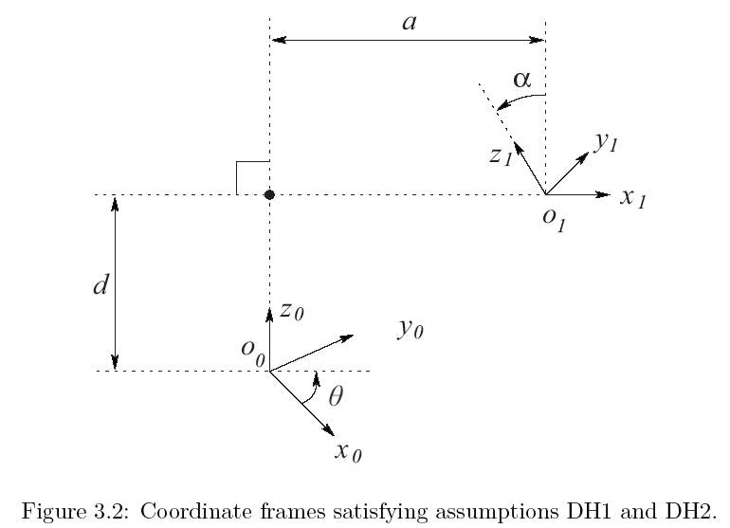
Denavit-Hartenberg

Slide 8
Denavit-Hartenberg
notice the form of the rotation component
this does not look like it can represent arbitrary rotations
can the DH convention actually describe every physically possible link configuration?

Slide 9
Denavit-Hartenberg
yes, but we must choose the orientation and position of the frames in a certain way
(DH1)
(DH2)
claim: if DH1 and DH2 are true then there exists unique numbers

Slide 10
Denavit-Hartenberg
proof: on blackboard in class

